Slide 1
IOT BASED WEATHER STATION
SUBMITTED TO : PROF. MIKE ALESHAMS
SUBMITTED BY :AJAY KUMAR VATTIKONDA
FROM GROUP1

Slide 2
ABOUT
THIS PRESENTATION IS ABOUT FINALIZING AND ORDERING HARDWARE COMPONENTS REQUIRED FOR THIS PROJECT

Slide 3
CONTENTS
LIST OF HARDWARE COMPONENTS USED IN THIS PROJECT
SPECIFICATIONS
STATUS OF THE ORDER SHIPPING

Slide 4
LIST OF HARDWARE COMPONENTS
BEAGLE BONE WIRELESS
ARDUINO UNO
16*2 LCD DISPLAY
TEMPERATURE AND HUMIDITY SENSOR
RAIN FALL DETECTION SENSOR
UV INDEX SENSOR
GSM MODULE

Slide 5
LIST OF HARWDARE COMPONENTS
SD CARD
BREAD BOARD
RESISTOR KIT
POWER ADAPTOR
ZERO PCB
Soldering kit with multimeter

Slide 6
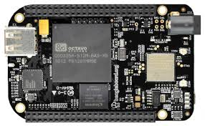
Beagle bone wireless

Slide 7
BEAGLE BONE WIRELESS
Based on the extreme successful open source hardware design of the beagle bone black.
Beagle bone wireless is a high expansion maker focused and community supported single board computer created by the beaglebone.org foundation in partner with the octavo system which is easy to use and compact in size

Slide 8
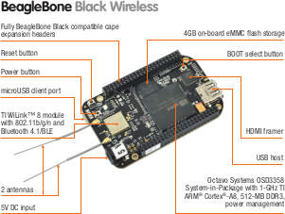
Beagle bone wireless

Slide 9
Beaglebone wireless
Beagle Bone Black Wireless was designed with maximum connectivity in mind, trading in the 10/100 Ethernet port from Beagle Bone Black for a high-performance 802.11 b/g/n 2.4GHz WiFi module with Bluetooth.
Beagle Bone Black Wireless introduces the Octavo Systems OSD3358 SiP (system-in-package) which integrates Beagle Bone functionality into one easy-to-use BGA package.

Slide 10
Beagle bone wireless specifications
The processor used is OSD3358 which is AM335x 1GHz ARM® Cortex-A8
Memory
12MB DDR3 800MHz RAM (Integrated in the OSD3358)
4GB 8-bit eMMC on-board flash storage with Debian pre-installed
microSD card slot

Slide 11
Beagle bone wireless specifications
Software compatibility:
Debian pre-configured with Cloud9 IDE on Node.js with BoneScript library
Third-party support of Android, Ubuntu and many more upon open source Linux kernel
Connectivity:
802.11b/g/n 2.4GHz WiFi, Bluetooth, and Bluetooth Smart Module

Slide 12
Beagle bone wireless specifications
High-speed USB 2.0 client port for serving files, network connections and more to a host PC providing both power and a development interface
Serial port access for UART0 with populated 6-pin 3.3V TTL header
Audio/video output
HDMI type-D (microHDMI) connector
Stereo/multi-channel audio over HDMI
Parallel LCD interface, I2S digital audio signals and touch screen controller via cape expansion headers

Slide 13
Beagle bone wireless specifications
Input is given via usb cable or 5v dc expansion header
Debug support: optional 20-pin cTI JTAG header and serial header

Slide 14
User input/output:
Reset button
Boot button
Power button
4 user configurable LEDs; WiFi and BT enable LEDs; power LED
Expansion header (cape header — BeagleBone Black compatible):
65 digital I/O with general purpose I/O, SPI, I2C, PWM, CAN, UART, SD, quadrature encoders and more
7 analog inputs
Power in/out

Slide 15
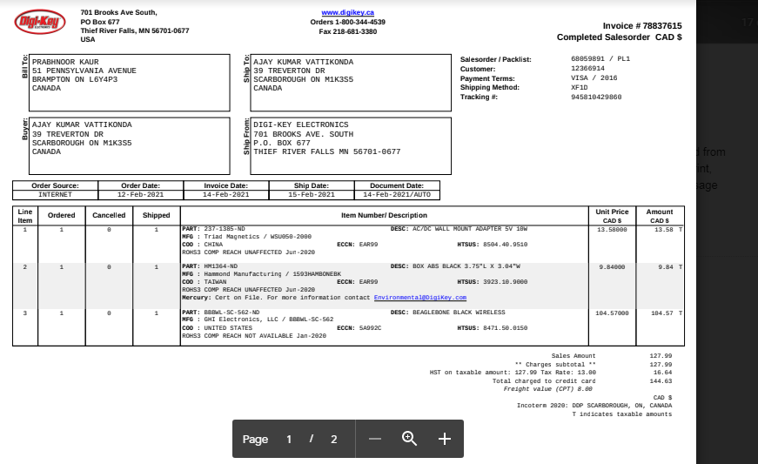
Order status
Ordered through digikey and is yet to receive

Slide 16
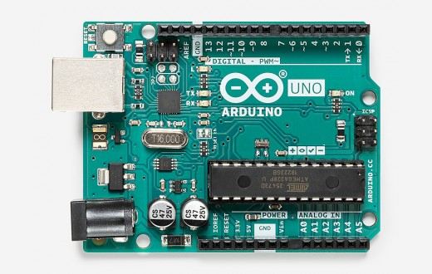
Arduino uno

Slide 17
Arduino uno
This is the second micro controller used in this project
The arduino uno is an open source microcontroller board based on the microchip ATmega328p microcontroller and developed by Arduino.cc

Slide 18
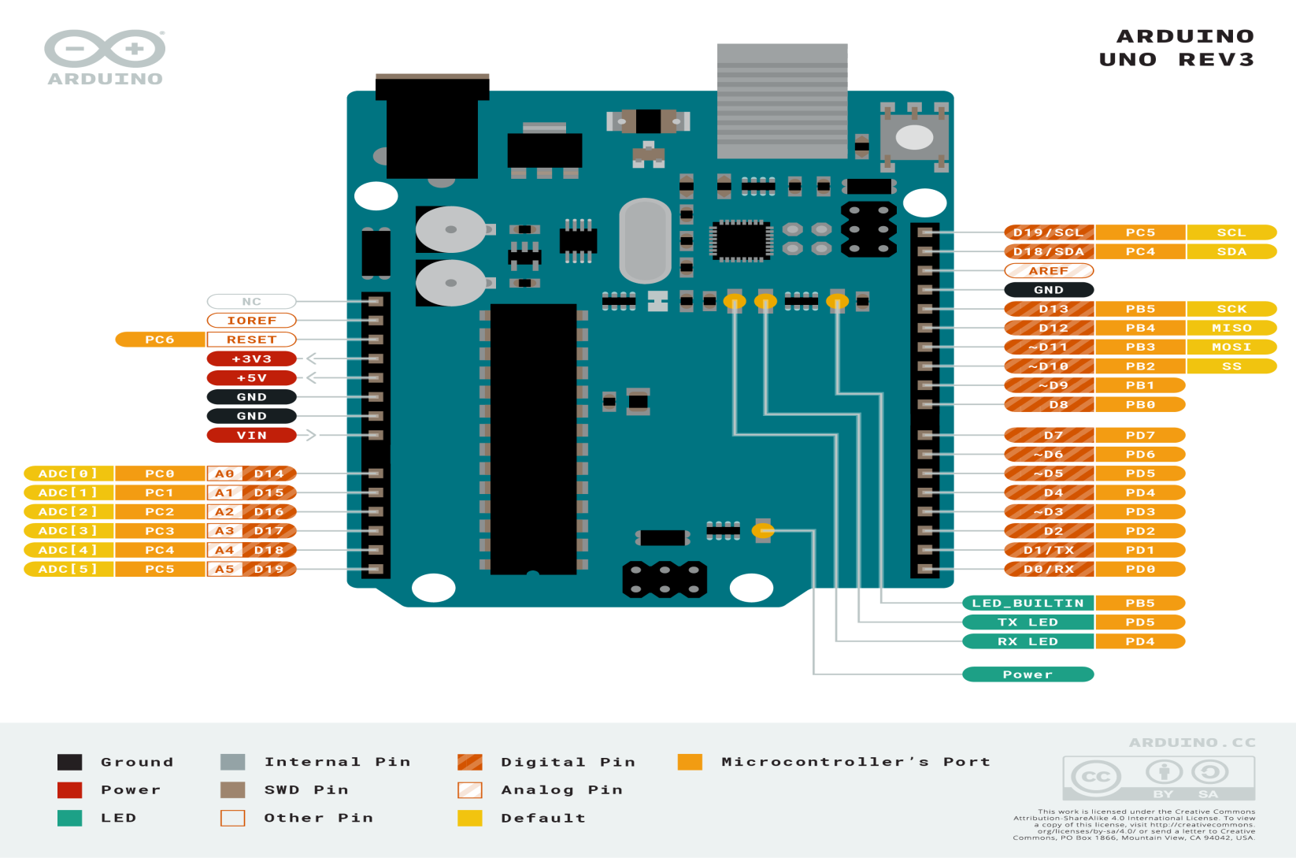
Arduino uno

Slide 19
Arduino uno specifications
It has 14 digital input/output pins (of which 6 can be used as PWM outputs), 6 analog inputs, a 16 MHz ceramic resonator (CSTCE16M0V53-R0), a USB connection, a power jack, an ICSP header and a reset button
Microcontroller - ATmega328p
Operating Voltage - 5V
Digital I/O Pins -14 (of which 6 provide PWM output)

Slide 20
Arduino uno specifications
Current- 50 mA max
flashMemory -32 KB
(ATmega328P) of which 0.5 KB used by bootloader
SRAM -2 KB
Clock Speed -16 MHz

Slide 21
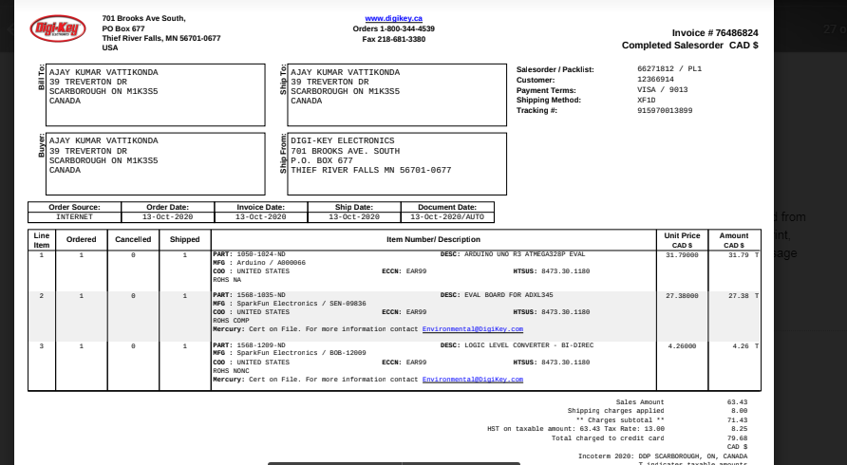
Component order status
The component has been ordered through digikey and is received

Slide 22
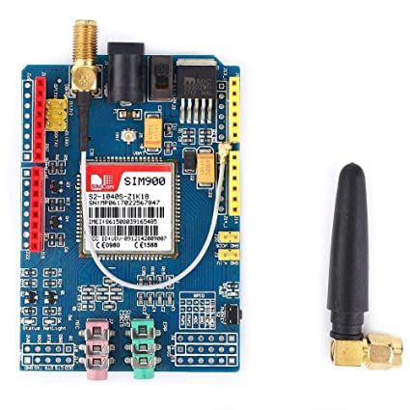
Gsm module (900) shield

Slide 23
GSM module 900 shield
SIM900 GSM/GPRS shield is a GSM modem, which can be integrated into a great number of IoT projects.
You can use this shield to accomplish almost anything a normal cell phone can; SMS text messages, Make or receive phone calls, connecting to internet through GPRS, TCP/IP, and more!
To top it off, the shield supports quad-band GSM/GPRS network, meaning it works pretty much anywhere in the world.

Slide 24
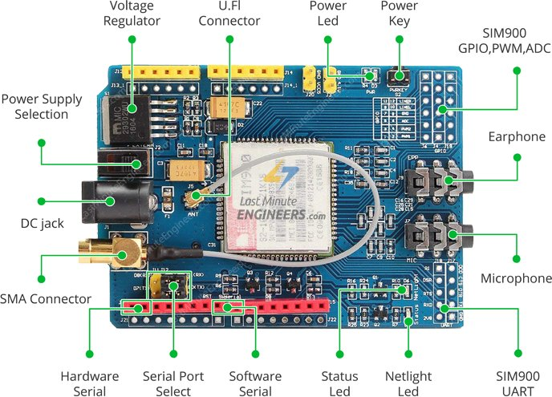
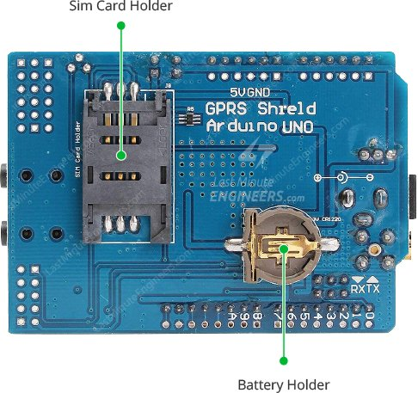
Gsm module 900 shield

Slide 25
Gsm module 900 shield features
The SIM900 shield packs a surprising amount of features into its little frame. Some of them are listed below:
Supports Quad-band: GSM850, EGSM900, DCS1800 and PCS1900
Connect onto any global GSM network with any 2G SIM
Make and receive voice calls using an external earphone & electret microphone
Send and receive SMS messages
Send and receive GPRS data (TCP/IP, HTTP, etc.)
Scan and receive FM radio broadcasts

Slide 26
GSm module shield general specifications
The operating voltage of SIM900 chip is from 3.4V to 4.4V. To keep supply voltage safe at 4.1V, the shield comes with a high current, high accuracy, low-dropout voltage regulator MIC29302WU from Micrel – capable of handling load currents up to 3A.
You can add an external power supply to the shield with the 5.5mm DC jack, to which you can connect any 5V-9V DC wall adapter you have.
The power supply should be able to source minimum 2A of surge current, otherwise the chip will keep shutting down.

Slide 27
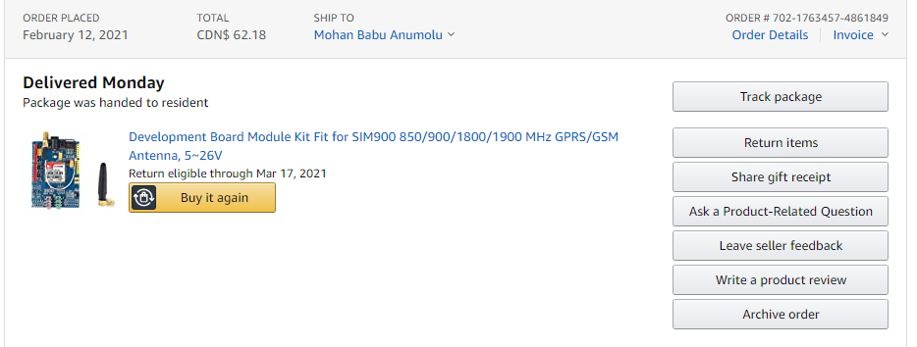
Status of the component order
The gsm module 900 shield has been ordered through amazon and the it is recieved

Slide 28
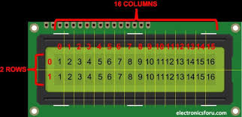
16*2 LCD display

Slide 29
16*2 lcd display
An LCD is an electronic display module that uses liquid crystal to produce a visible image. The 16×2 LCD display is a module commonly used in circuits. The 16×2 translates o a display 16 characters per line in 2 such lines

Slide 30
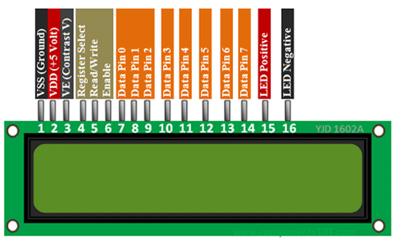
16*2 lcd display

Slide 31
16*2 lcd display features
Operating Voltage is 4.7V to 5.3V
Current consumption is 1mA without backlight
Alphanumeric LCD display module, meaning can display alphabets and numbers
Consists of two rows and each row can print 16 characters.
Each character is build by a 5×8 pixel box
Can work on both 8-bit and 4-bit mode
It can also display any custom generated characters
Available in Green and Blue Backlight

Slide 32
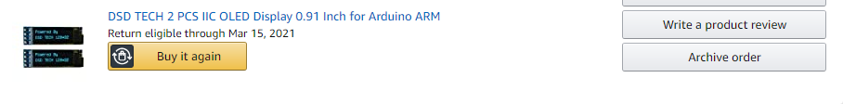
Component order status
The component is ordered from amazon and it is received

Slide 33
Sensors used in this project
Temperature and humidity sensor
Rain detection sensor
Uv index sensor

Slide 34
Temperature and humidity sensor
DHT11 sensor is temperature and humidity sensor
The DHT11 is a basic, low-cost digital temperature and humidity sensor. It uses a capacitive humidity sensor and a thermistor to measure the surrounding air, and spits out a digital signal on the data pin.In this Temperature will display in Celsius. Humidity (H) will display in %.

Slide 35
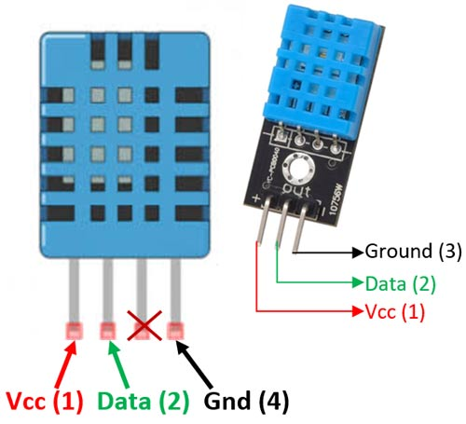
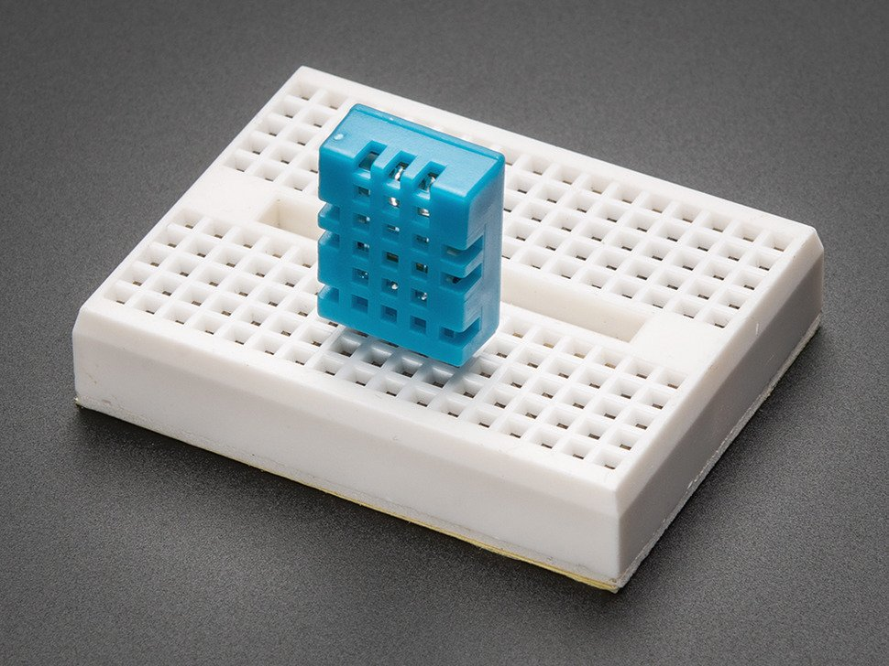
DHT11 sensor

Slide 36
DHT11 sensor specifications
Low cost
3 to 5V power and I/O
2.5mA max current use during conversion (while requesting data)
Good for 20-80% humidity readings with 2-5% accuracy
Good for 0 to 50°C temperature readings ±0.5°C accuracy
Body size 15.1mm x 25mm x 7.7mm
4 pins with 0.1" spacing

Slide 37
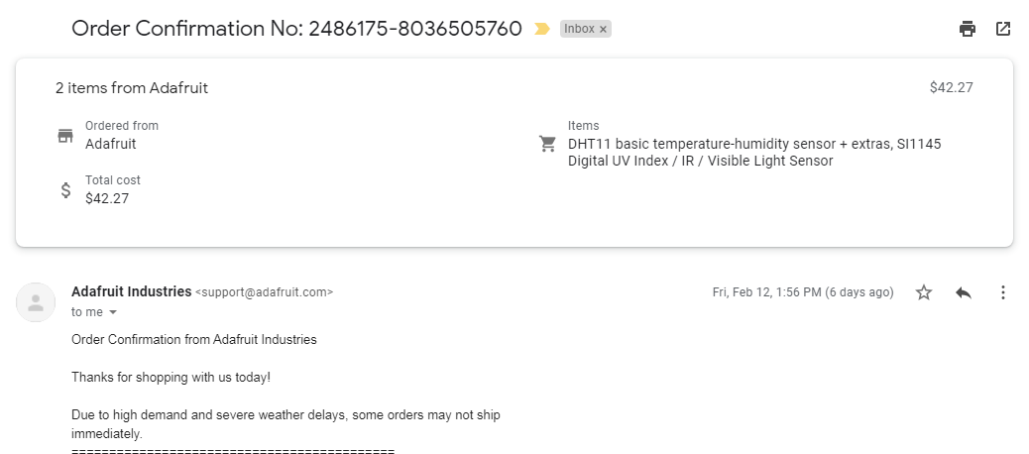
Component order status
The component is ordered from adafruit website and has not been shipped yet

Slide 38
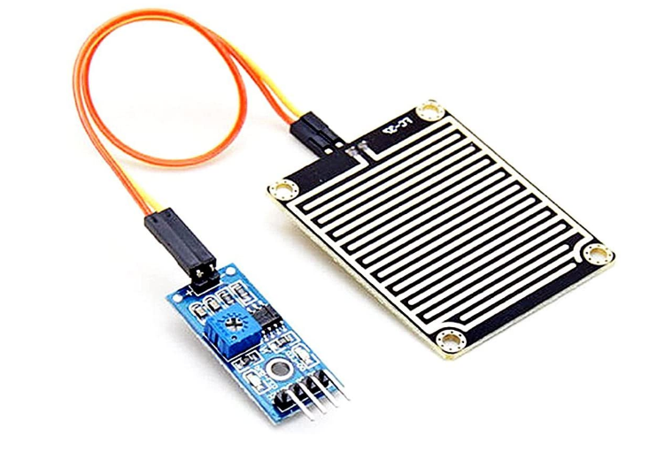
Rain detection sensor module

Slide 39
Rain detection sensor module
The Rain board module consists of two copper tracks, designed in such a way that under the dry conditions they provide high resistance to the supply voltage, and this output voltage of this module will be 5V.
This module’s resistance gradually decreases with respect to an increase in the wetness on the board.

Slide 40
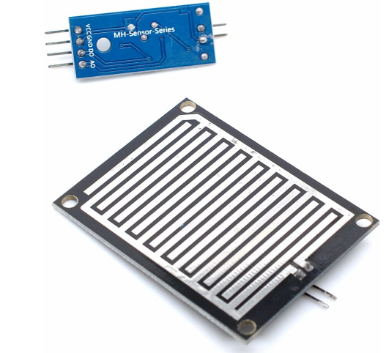
Rain detection sensor module
As the resistance decreases, its output voltage also decreases with respect to the wetness on the module.
The Rain board module consists of two pins used to connect to the control board.

Slide 41
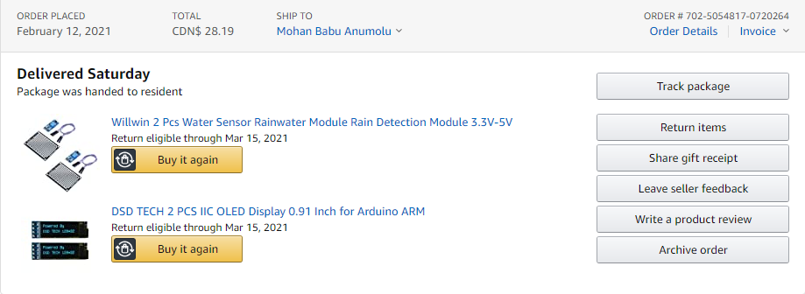
Component order status
The component has been ordered through amazon and has been received

Slide 42
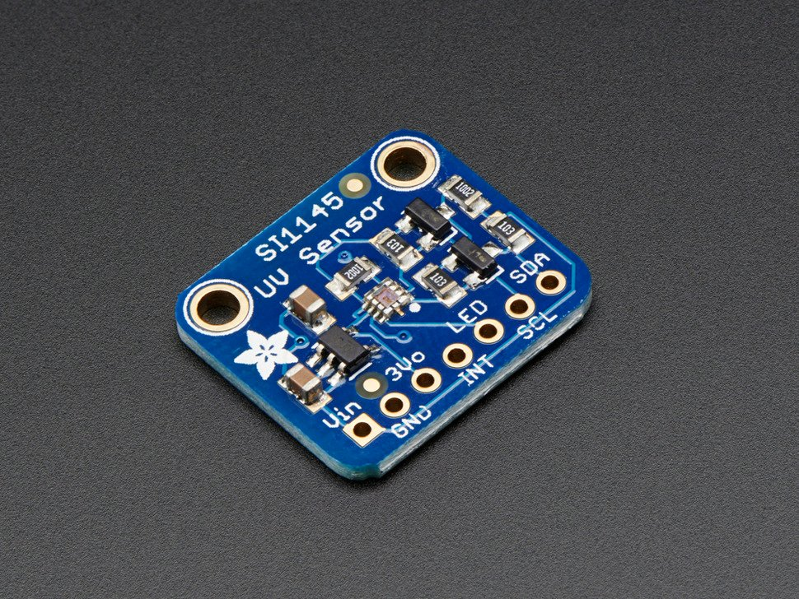
Uv index sensor

Slide 43
Uv index sensor
The SI1145 is a new sensor from SiLabs with a calibrated light sensing algorithm that can calculate UV Index.
It doesn't contain an actual UV sensing element, instead it approximates it based on visible & IR light from the sun.

Slide 44
We took this outside a couple days and compared the calculated UV index with the news-reported index and found it was very accurate! It's a digital sensor that works over I2C so just about any microcontroller can use it.
The sensor also has individual visible and IR sensing elements so you can measure just about any kind of light - we only wrote our library to printout the 'counts' rather than the calculate the exact values of IR and Visible light so if you need precision Lux measurement check out the TSL2561.

Slide 45
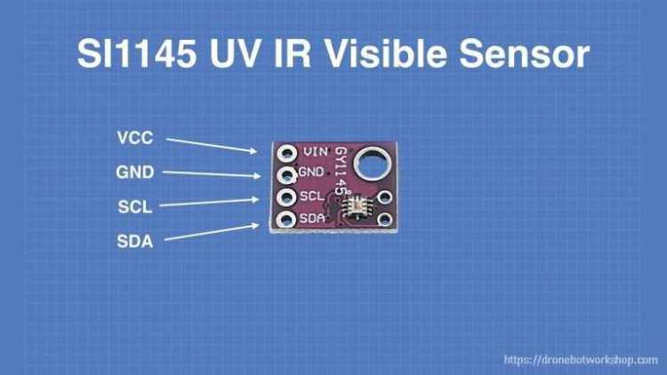
Uv index sensor general specifications
Voltage Supply: Power with 3-5VDC
Output Type: I2C address 0x60 (7-bit)
Operating Temperature: -40°C ~ 85°C

Slide 46
Component order status
The component has been ordered through adafruit website and has not been received

Slide 47
Other equipment needed for project
SD card
Breadboard
Power adaptor
Soldering kit with multimeter
Resistor kit
Zero pcb

Slide 48
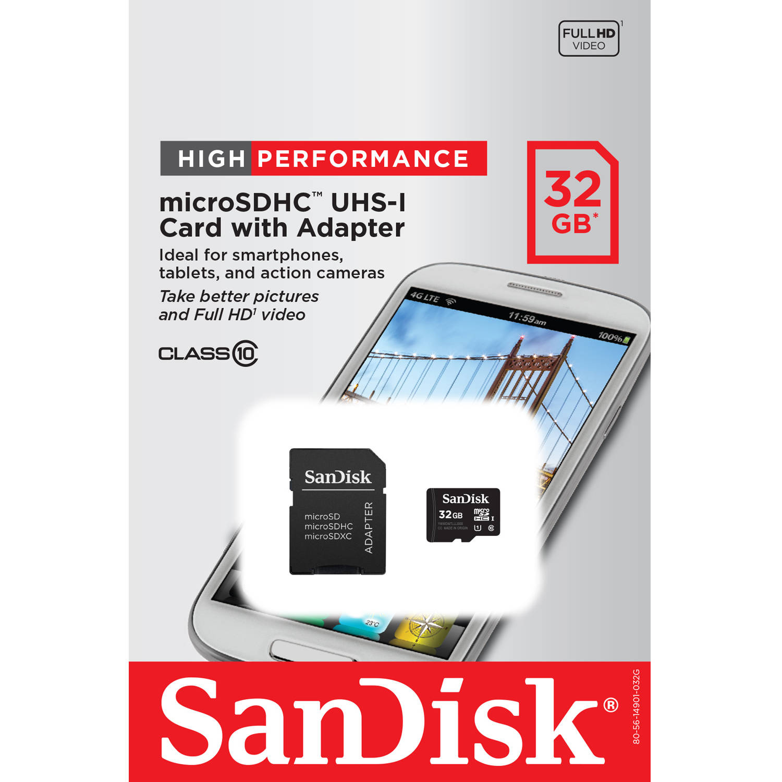
SD card
Sd card is used to store the latest image of debian
Then we can flash the latest image to the beagle bone

Slide 49
Component status
The component has been bought from walmart and is received.

Slide 50
Breadboard
A breadboard is a construction base for prototyping of electronics
Because the solderless breadboard does not require soldering, it is reusable. This makes it easy to use for creating temporary prototypes and experimenting with circuit design. For this reason, solderless breadboards are also popular with students and in technological education. Older breadboard types did not have this property

Slide 51
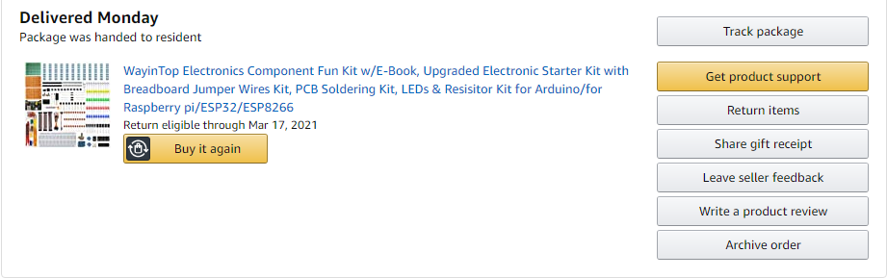
Component order status

Slide 52
Power adaptor
The adaptor is used to power the beaglebone wireless and its specifications are
Voltage Output- 5V
Current Output- 2A Max
Operating Temperature- 0-40 degrees
NL power consumption- 100mW max
Power- 10W

Slide 53
Component order status
The component has been ordered through digikey and has been not received yet.

Slide 54
Soldering kit with multimeter
The soldering kit is used to solder the components on pcb board.
After successful prototyping on the breadboard we can transfer the design to pcb board and solder all the components with soldering kit
Digital multimeter is used to read the volatge or current in the circuit between various components

Slide 55

Soldering kit with multimeter

Slide 56
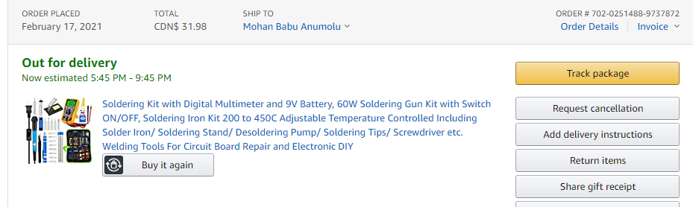
Component order status
The component has been ordered through amazon and will receive soon

Slide 57
Resistors kit
A resistor is a passive two-terminal electrical component that implements electrical resistance as a circuit element.
In electronic circuits, resistors are used to reduce current flow, adjust signal levels, to divide voltages, bias active elements, and terminate transmission lines, among other uses.

Slide 58
Component order status
It has been ordered though amazon along with the breadboard kit and is recieved

Slide 59
Zero pcb
A printed circuit board (PCB) mechanically supports and electrically connects electrical or electronic components using conductive tracks, pads and other features etched from one or more sheet layers of copper laminated onto and/or between sheet layers of a non-conductive substrate.

Slide 60
Component order status
The component has been ordered through amazon and is received.

Slide 61
Reference
For Beagle bone wireless
https://beagleboard.org/blog/2016-09-26-meet-beaglebone-black-wireless
http://shukra.cedt.iisc.ernet.in/edwiki/File:Bbb_wireless.png
For arduino
https://store.arduino.cc/usa/arduino-uno-rev3

Slide 62
Reference
For gsm module
https://lastminuteengineers.com/sim900-gsm-shield-arduino-tutorial/#:~:text=SIM900%20GSM%2FGPRS%20shield%20is,TCP%2FIP%2C%20and%20more!
For 16*2 lcd display
https://components101.com/16x2-lcd-pinout-datasheet

Slide 63
Reference
For DHT11 sensor
https://www.adafruit.com/product/386#tutorials
For rain detection sensor module
https://circuitdigest.com/microcontroller-projects/rain-detector-using-arduino
For uv index sensor
https://www.adafruit.com/product/1777#tutorials

Slide 64
Refernce
Others
https://en.wikipedia.org/wiki/Breadboard
https://en.wikipedia.org/wiki/Resistor
https://en.wikipedia.org/wiki/Printed_circuit_board

Slide 65
Thank you

